Slide 1



Adaptive
Testing with
Concerto
Using open source to keep adaptive testing
in tune and on time
“Learning from other fields”
Chris Gibbons
Director of eHealth Assessment and NIHR Fellow
The Psychometrics Centre and Cambridge Centre for Health Services Research
University of Cambridge

Slide 2
The Psychometrics Centre
History
Founded by Prof John Rust in 1989; Joined the Judge Business School in 2015
Multidisciplinary team of psychologists, statisticians, mathematicians, computer scientists, linguists, engineers and entrepreneurs across the University
Mission
To establish the University of Cambridge as an international centre of excellence in computational behavioural science and adaptive measurement
Expertise and interests
Digital footprint analysis
Psychological assessment
PROMs development
Computer adaptive testing
Big Data & Machine-learning
Unstructured Text
Facial rec & Image Analysis
Open-source software

Slide 3
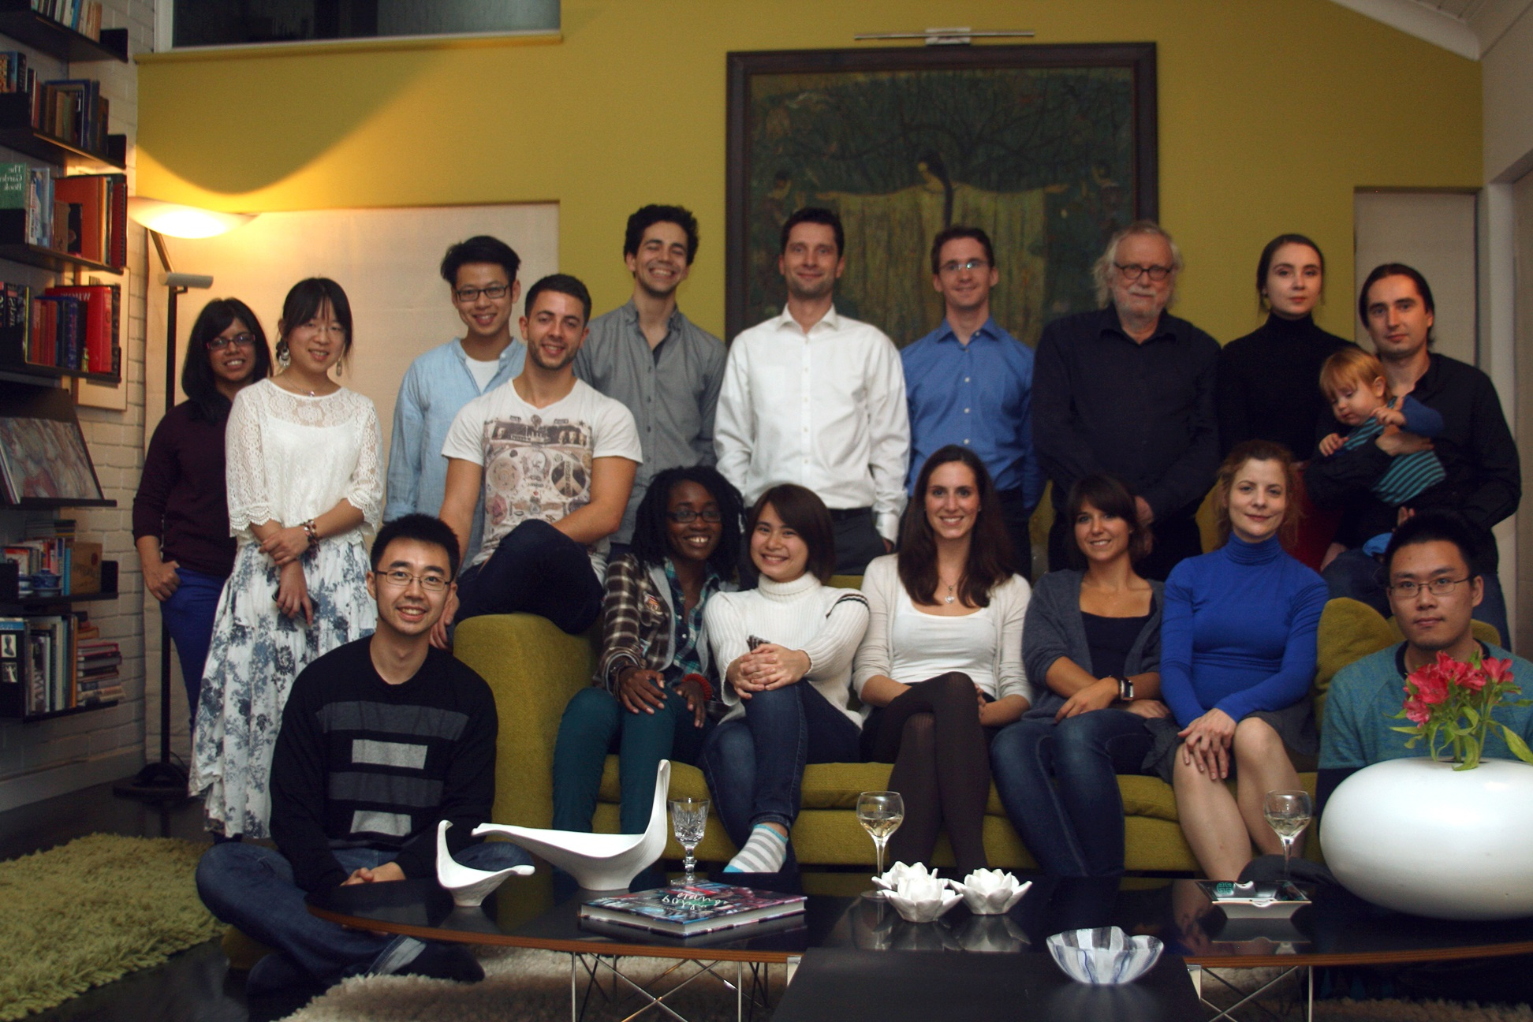
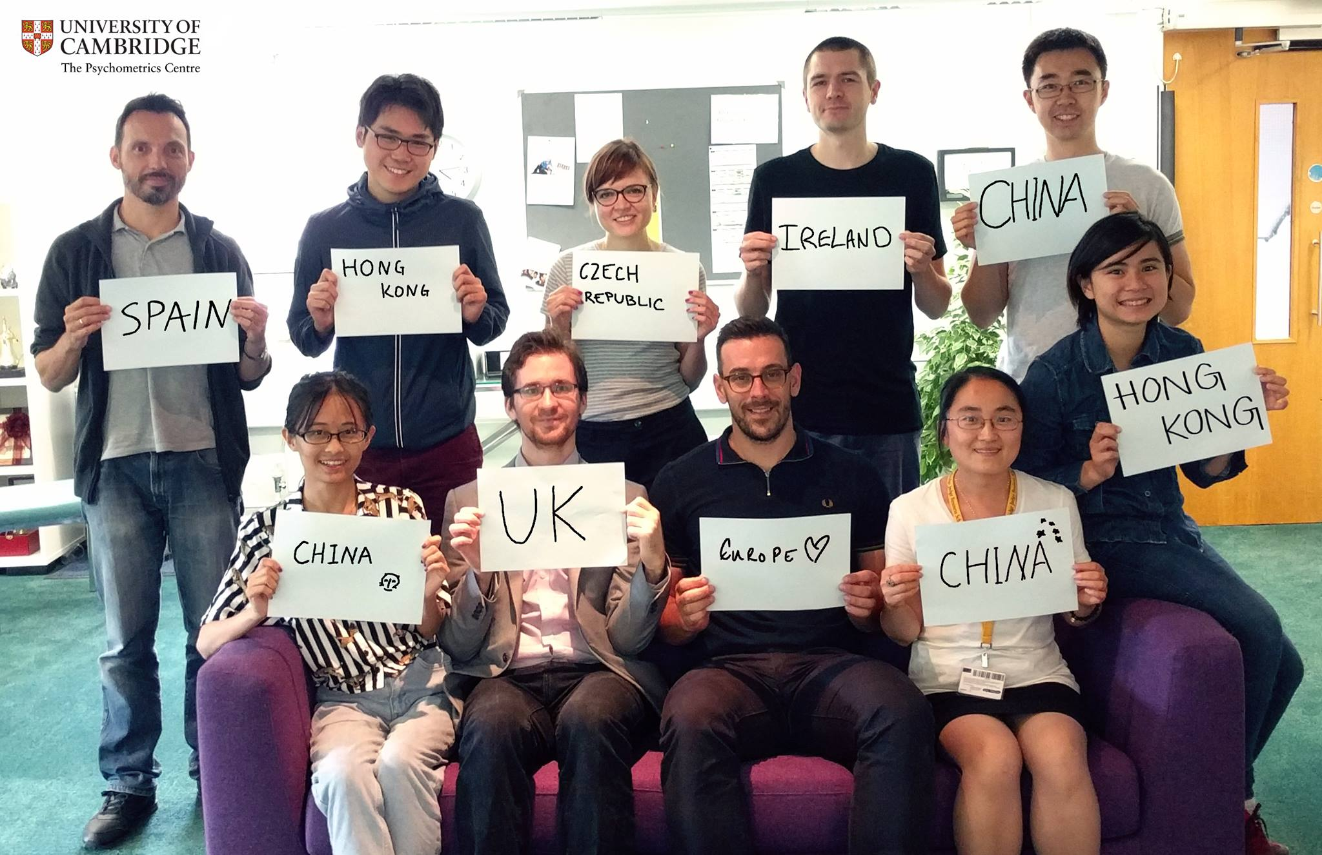
The Psychometrics Centre

Slide 4
Vision
Adaptive and electronic measurement should be widely available to non-experts.
It should always be free and open-source.
Assessment experience should be made as enjoyable as possible.
Users should be able to tailor a computer adaptive test easily.
Data security protocol should be dictated by the test-developer.
Where expertise is needed, it be should be readily available as consultancy or training.

Slide 5



CCHSR

Slide 6
Today
Open science
myPersonality – big personality assessment
Open source
Concerto – open source flexible adaptive testing
Why flexible, open source technologies are the future for patient-reported assessments

Slide 7
Open science
Accessible to everyone
Transparent
Interesting
Progress faster and farther

Slide 8
Open science
Open Data
Open Methods / Code
Open Publication

Slide 9
(not so) Open science
Newton on calculus (1677 letter to Liebnitz)
“The foundations of these operations is evident enough, in fact; but because I cannot proceed with the explanation of it now, I have preferred to conceal it thus: On this foundation I have also tried to simplify the theories which concern the squaring of curves, and I have arrived at certain general Theorems”
6accdae13eff7i3l9n4o4qrr4s8t12ux

Slide 10
Open data
data”
“While the 20th century was about oil, the next century is going to be about
Ginni Rometty, CEO IBM

Slide 11
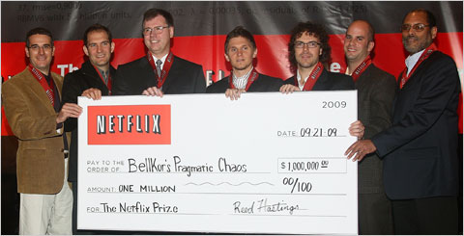
Open data

Slide 12




myPersonality
Feedback was the only incentive
7mil individual psych & social profiles
25 validated psychometric tests

Slide 13

myPersonality

Slide 14
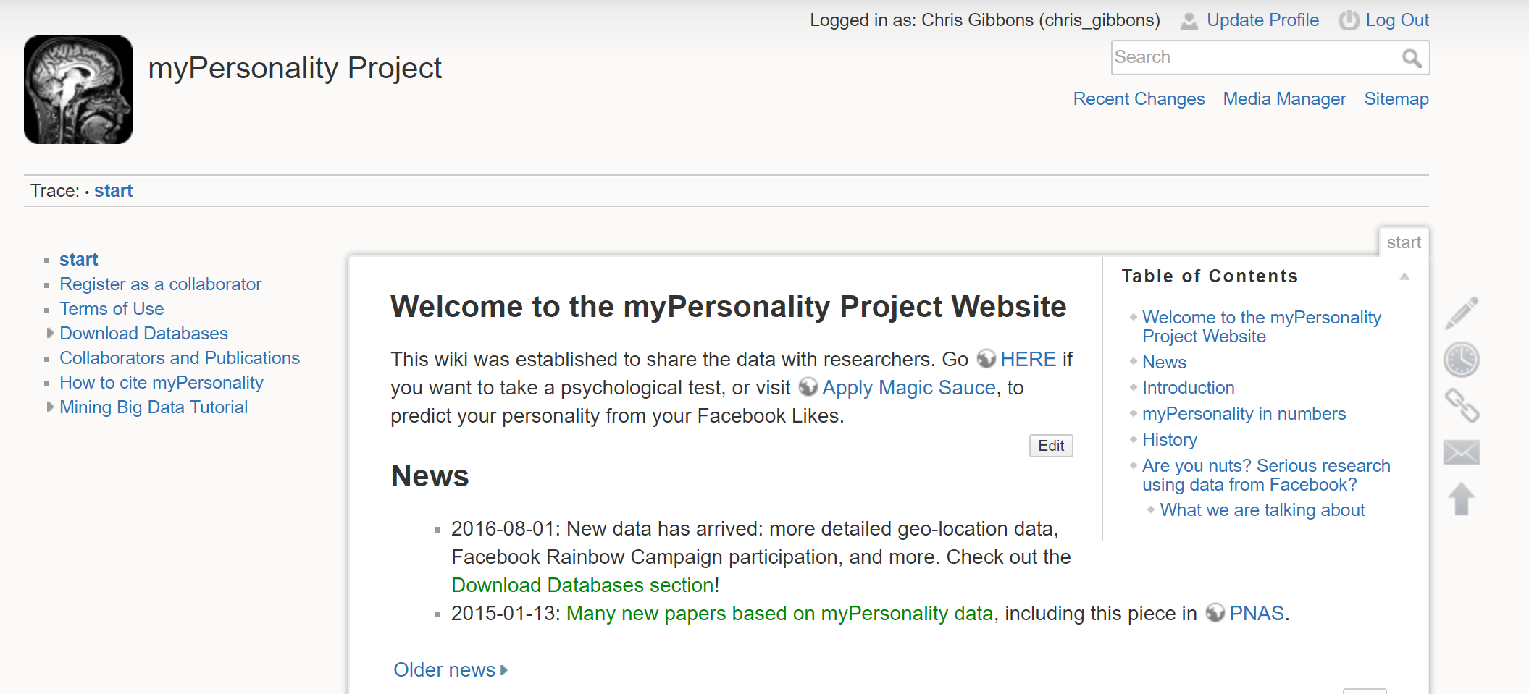
myPersonality

Slide 15

myPersonality
80+ institutions

Slide 16






myPersonality

Slide 17


myPersonality
Question:
Can you build a predictive model of a psychometric test (BIG-5) using Facebook ‘likes’ and machine learning?

Slide 18

myPersonality
Do you like PROMIS Health Organisation? YES | NO

Slide 19
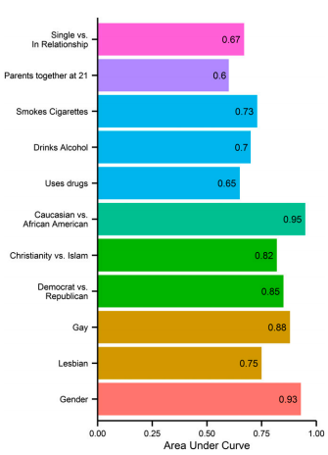
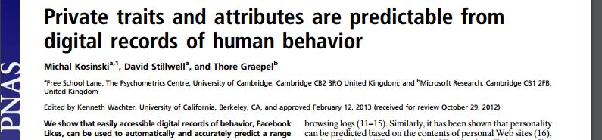
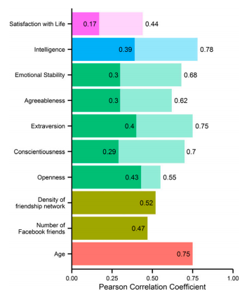
myPersonality

Slide 20
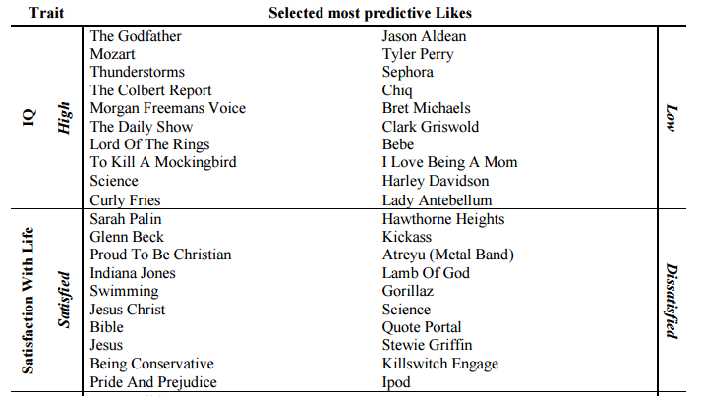
myPersonality

Slide 21
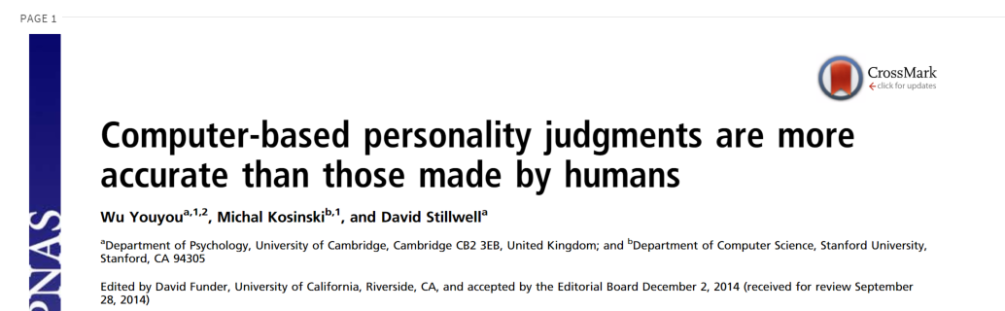
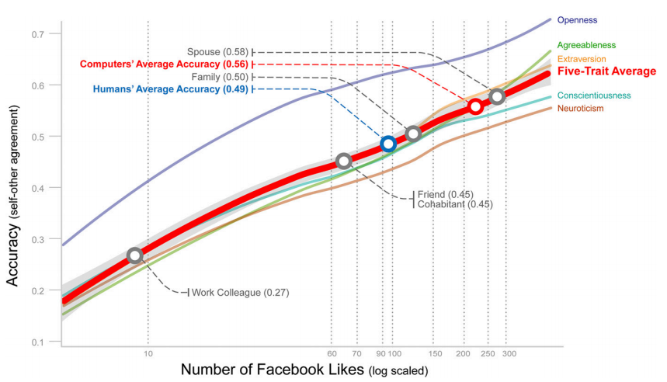
myPersonality

Slide 22
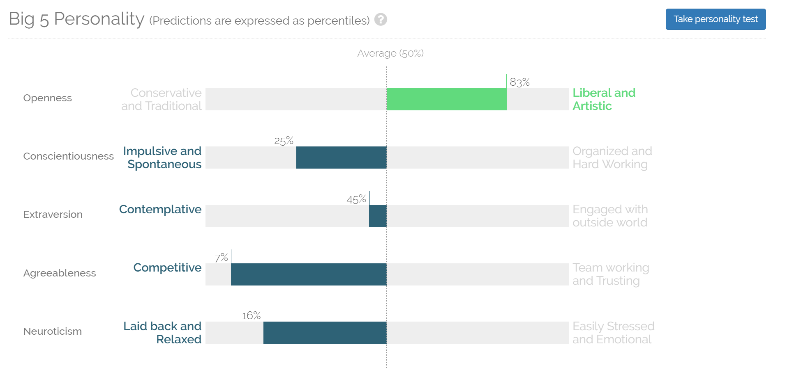
myPersonality
applymagicsauce.com

Slide 23
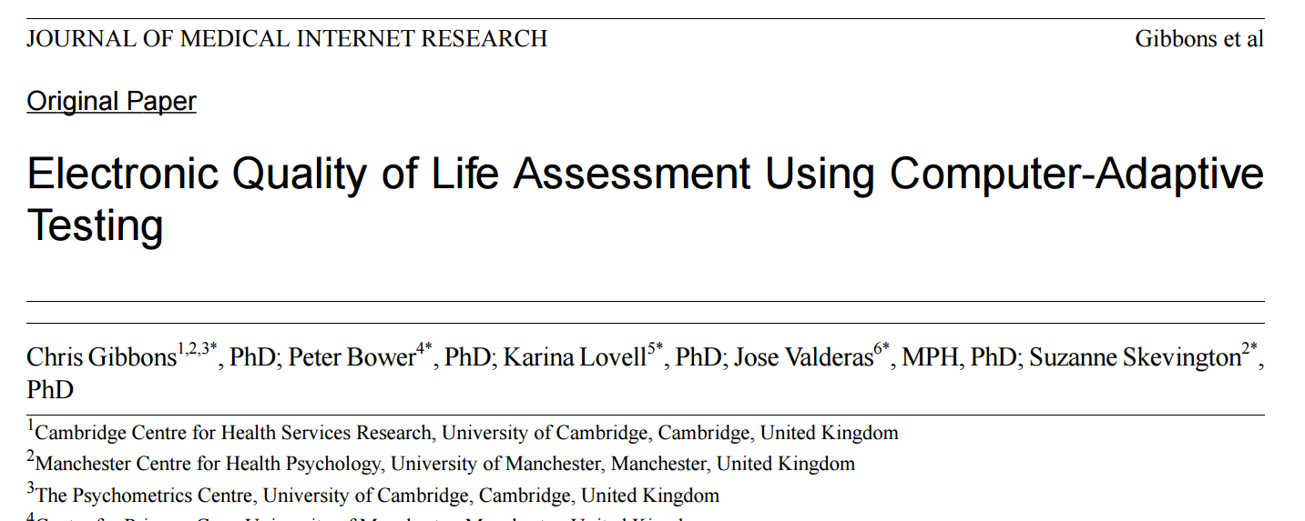
myPersonality
applymagicsauce.com

Slide 24
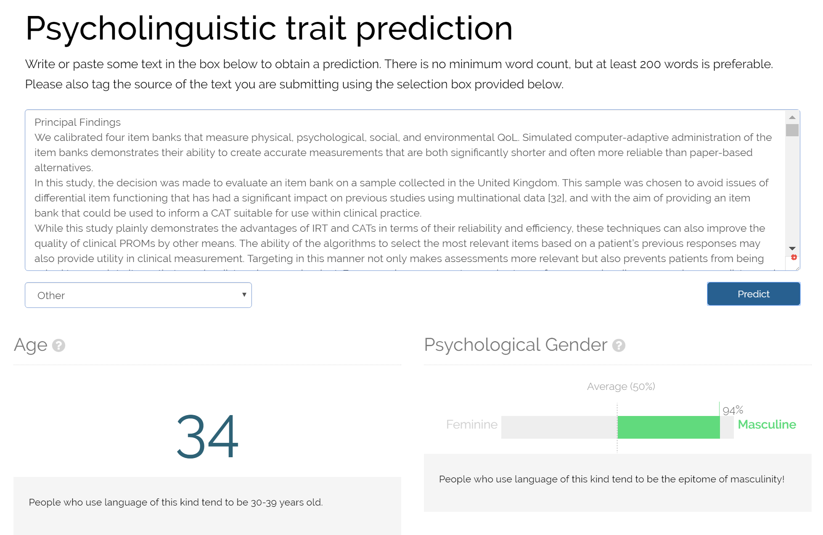
myPersonality

Slide 25
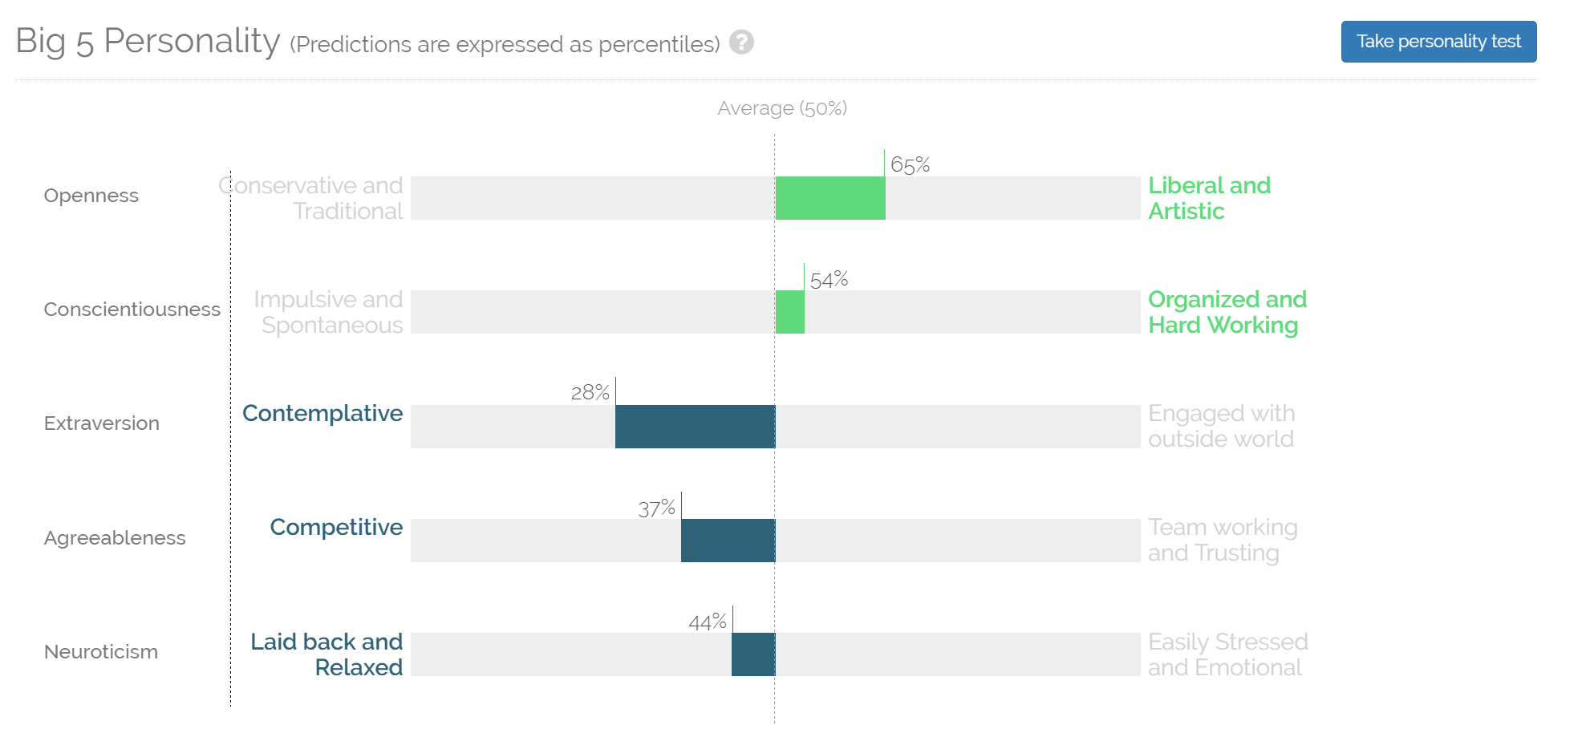
myPersonality
applymagicsauce.com

Slide 26





Instagram and depression

Slide 27
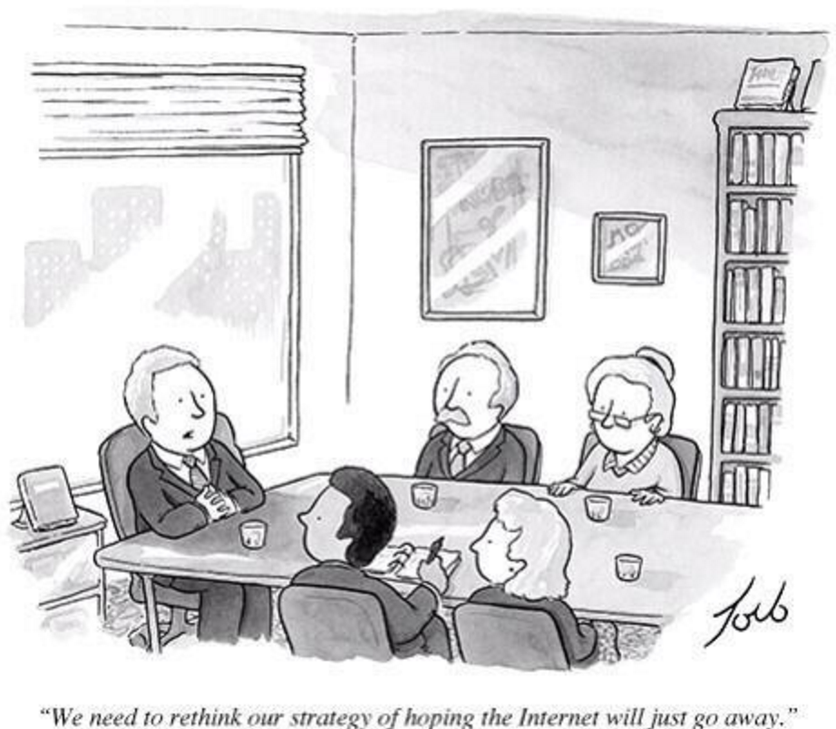
Machine learning, big data, and statistical inference have
BIG
roles to play in the future of
psychometrics and psychological
assessment

Slide 28
Open source
“Ideas and tools for which the source code is made freely-available and may be redistributed and modified”

Slide 29




Open source myths
“It makes no business sense, so why do it?”

Slide 30
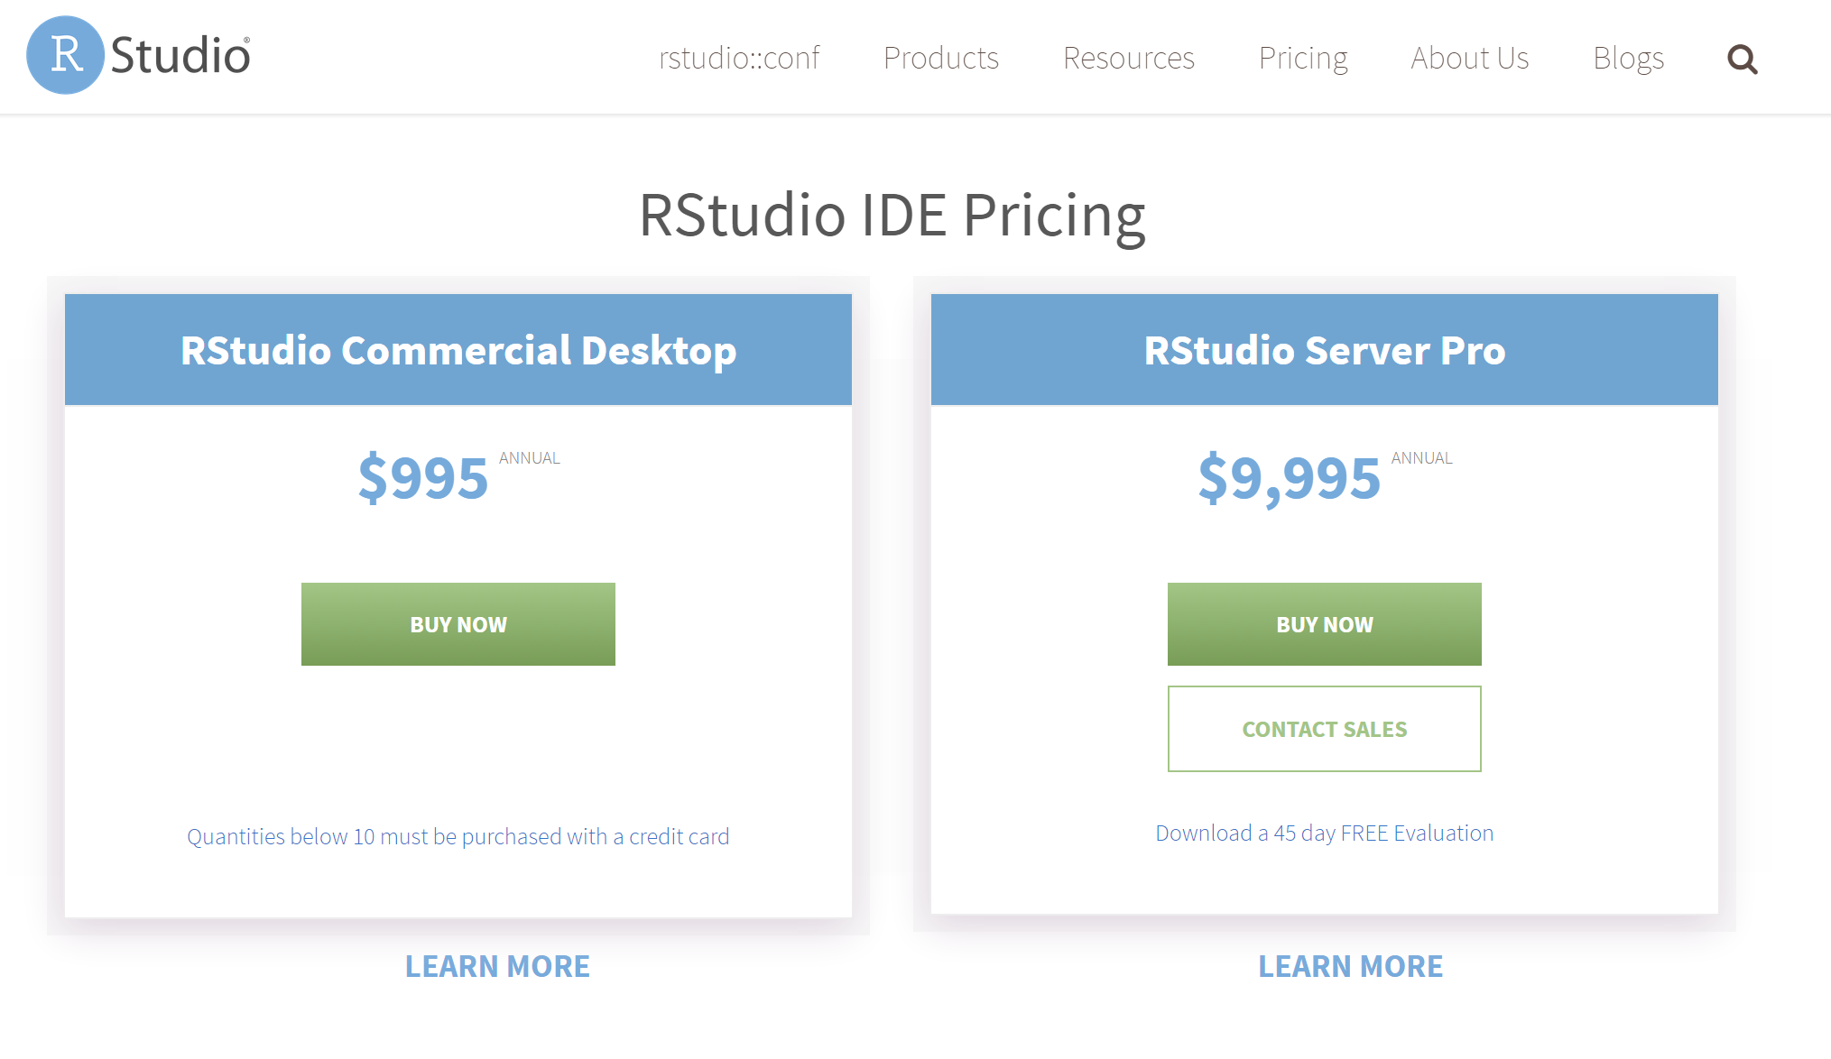
Open source myths
“You’ll never make any money”

Slide 31


Open source myths
“Open source means poor quality”
98% of internet servers
80% of mobile devices
96.4% of PROMIS analyses*
*- a guess, but you get the idea

Slide 32





Open source

Slide 33


Concerto

Slide 34
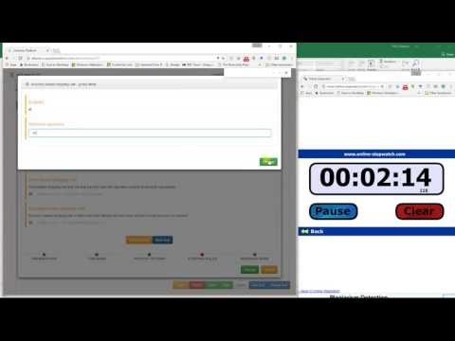
Concerto

Slide 35
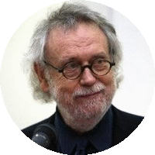
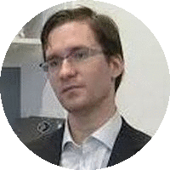
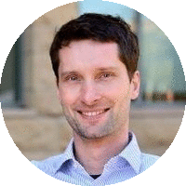

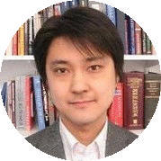

People
Prof John Rust
Director
Psychometrics Centre
Dr David Stillwell
Deputy Director
Psychometrics Centre
Dr Michal Kosinski
Computational Psychology
Stanford University
Przemyslaw Lis
Software Engineer
University of Cambridge
Dr Tomoya Okubo
Psychometrician
NCUEE Tokyo
Dr Chris Gibbons
Director of eHealth Assessment
Psychometrics Centre

Slide 36
The Concerto project
Concerto v1 launched
Concerto v5 launched
2011
2017

Slide 37
The Concerto project
The Hard Stuff
The Easy Stuff
2011
2017

Slide 38
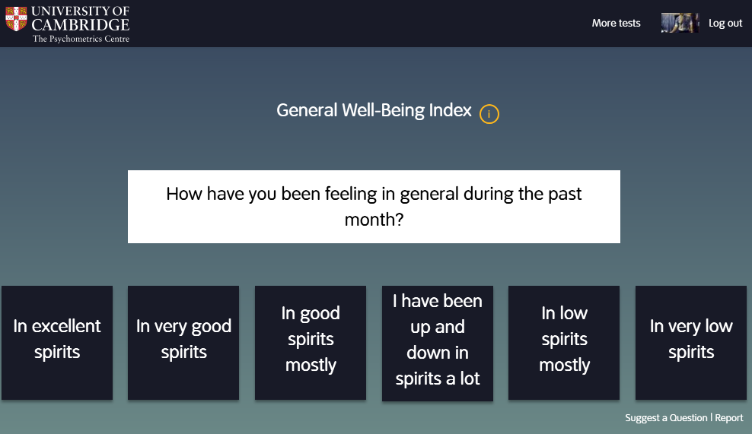
Example tests_

Slide 39
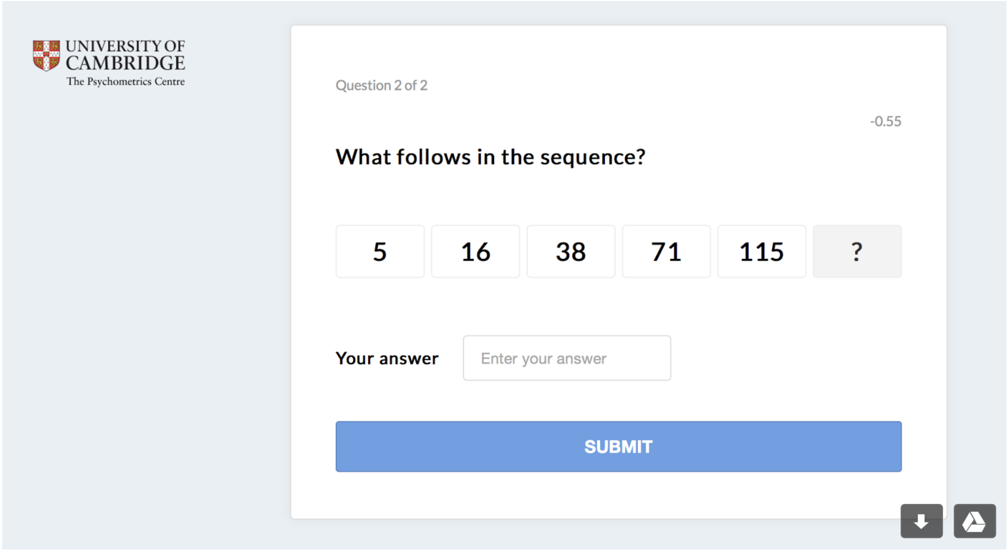
Example tests_

Slide 40
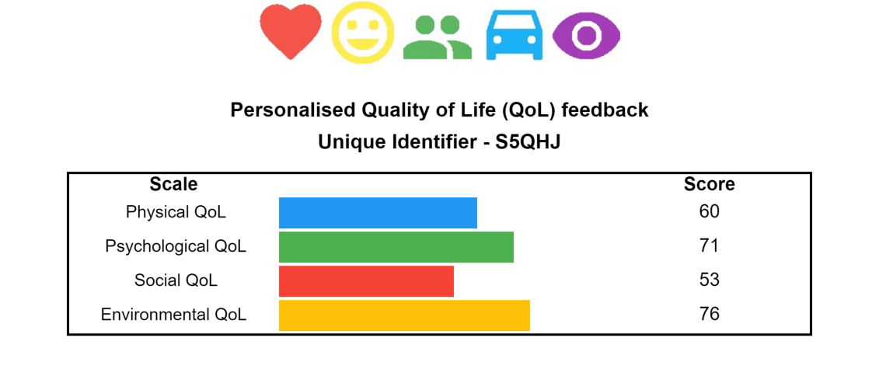
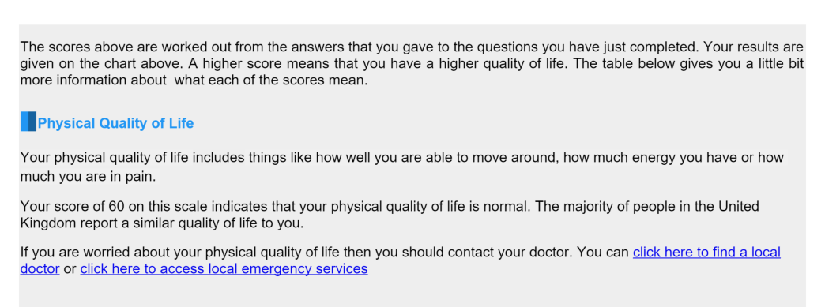
Example tests

Slide 41
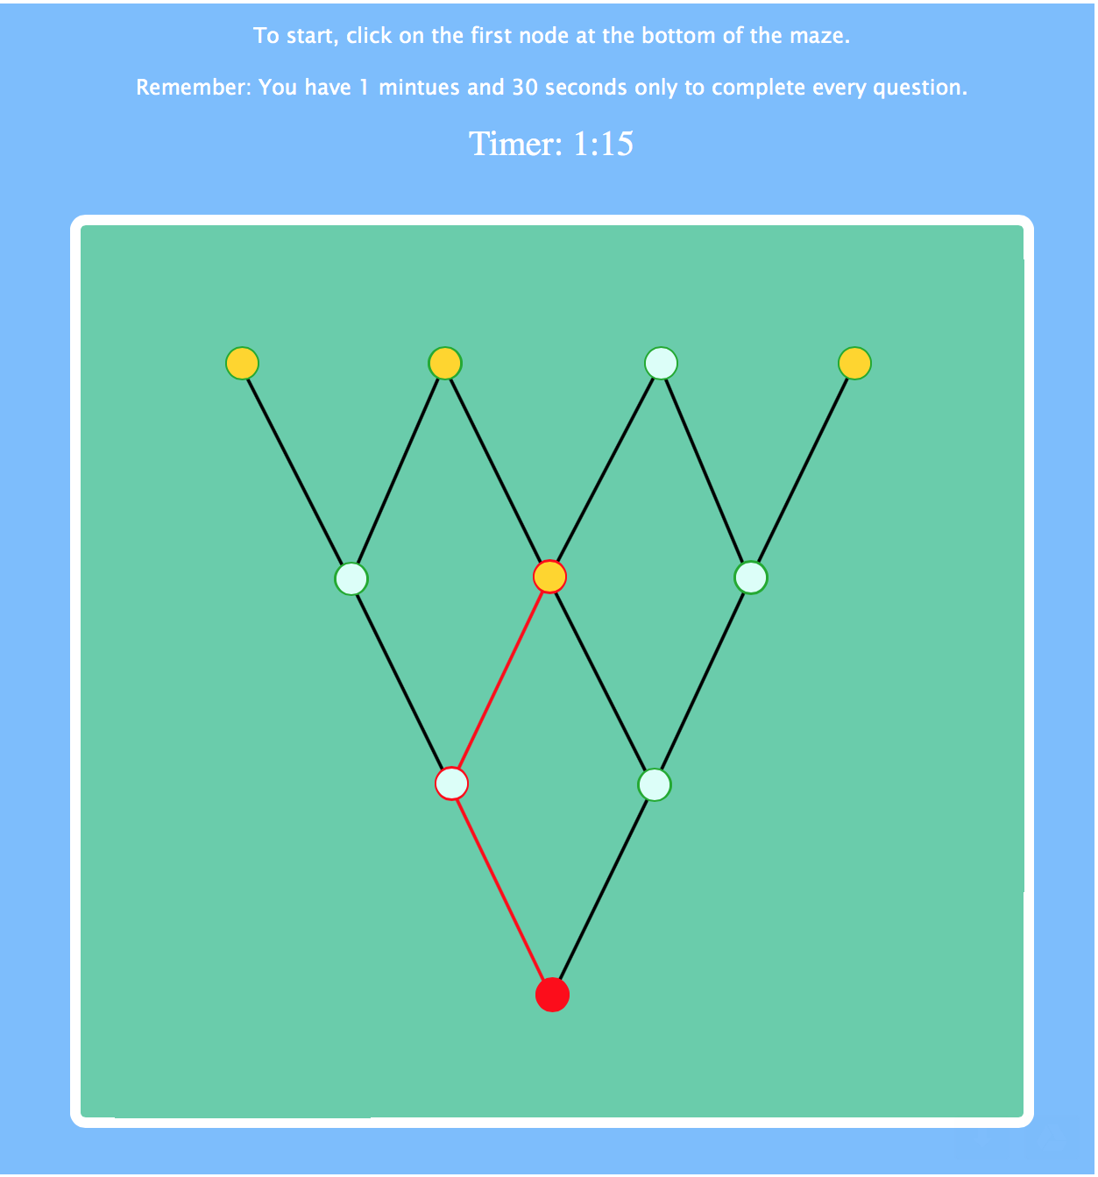
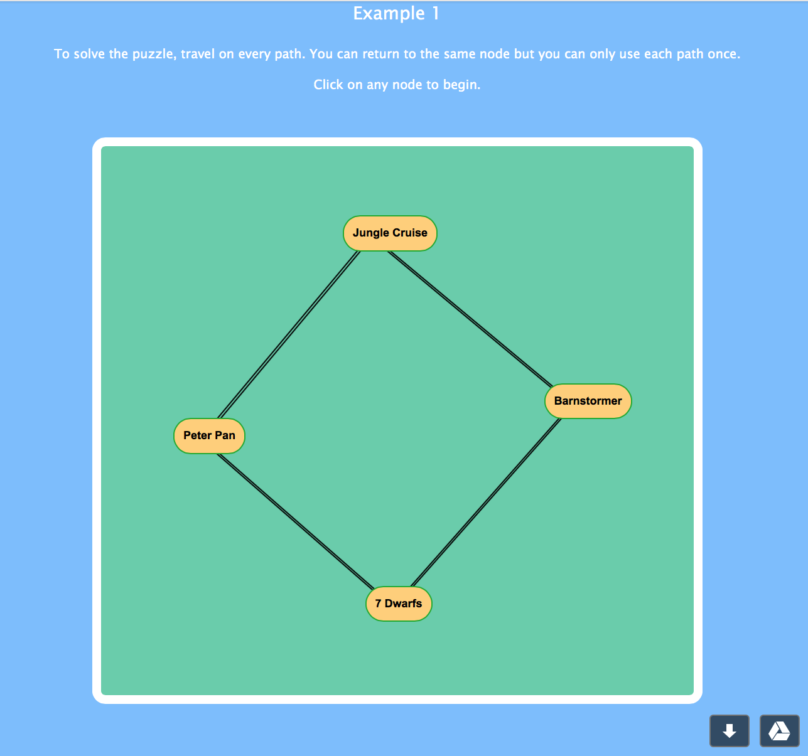
Example tests_

Slide 42

In practice
Literacy and numeracy tests
Computer adaptive
800 assessments a year
Students get results in 2 minutes
Tests are sat ‘on demand’
Feedback given on items students got wrong

Slide 43

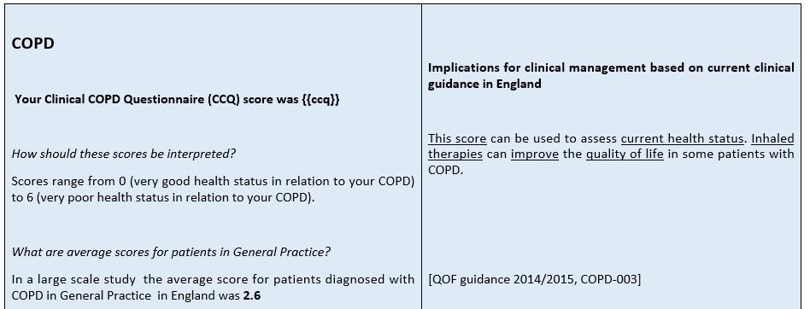
In practice

Slide 44

In practice

Slide 45

In practice

Slide 46







In practice

Slide 47





Concerto
Installable on different platforms
Cloud servers (free trial on Amazon)
Physical server
(at your University/hospital)
Docker
Windows 10 tablet
Linux Installation
User-defined data security
Flexible speed and data-storage for scalable tests (up to millions of users)

Slide 48

Distributed innovation in Concerto
Collaborators
Patient and stakeholder feedback
Case-specific adaptation
Deployment of open source software
Better products
More widely used
Brand recognition
Product development
Academic collaboration
Consultancy
Skills and learning
Paid support
Recruitment

Slide 49
Distributed innovation in Concerto
Spanish, French and Turkish translations
Multiple feedback templates
Predictions of unseen questions
Local dependency and DIF logic
Stopping rule innovations

Slide 50
Openness means
letting go
.. just a little bit

Slide 51
Benefits of losing control
Bigger data
Better science
Uptake
Collaboration
New ideas
Recruitment
Better products
Innovative funding

Slide 52
Benefits of losing control
Bigger data
Better science
Uptake
Collaboration
New ideas
Recruitment
Better products
Innovative funding

Slide 53
Benefits of losing control
Bigger data
Better science
Uptake
Collaboration
New ideas
Recruitment
Better products
Innovative funding

Slide 54
Closing thoughts
The context of every assessment is different and end users know more about what they want than you do.
Being prescriptive about how assessments should look and work stifles innovation and disengages ‘high value’ users.
Free at point-of-use products are well used.
Making platforms flexible and open-source empowers a distributed network of experts to take adaptive testing to new levels.

Slide 55
Thank you
www.concertoplatform.com
Slides available at drchrisgibbons.com
Twitter
@campsych
@cam_concerto
@drcgibbons

